Slide 1

UMKC RIDE
By - Avinash Ganguri, Bhashitha Siddareddy, Divya Reddy Bandari

Slide 2
Build a Hybrid Application for UMKC to provide convenient transportation facilities to the students and staff. The App allows users to request a pickup. The request is sent with the location, and the nearest driver will be notified about the pickup location. Once the driver accepts the pickup, it automatically routes the driver with least possible distance and Estimated Time Average.
OBJECTIVE

Slide 3
Motivation
Instead of coming to a common bus stop or place where everyone can come, rather a user can request a pickup from their location and then a shuttle nearby accepts it and gets to the pickup point.

Slide 4
Features
A web application to electronically create organization admins, drivers and vehicles with validations.
A mobile application which will allows users to request for pick and view the Estimated time of arrival.
Identifying and allocating least ETA to users with respect to driver approval.
Approve or Reject the request.
Automatically routing the driver to the user’s location with the least distance and time option with a real time tracking of shuttle location.
Web application of organization admin to view their specific organization’s drop off and pick ups information.
Run on both Android and IOS

Slide 5
About Web UI
Below type of users can login to their respective tasks
App owner
Organizations Admin
Manage Organizations and Admins
Add new “Line of Business” (Organization)
Create an account for Organization Admin
View lists of Line Of Business and their specific admins
Manage Drivers and Vehicles
Add Drivers to their organization and assign a shuttle to them
Add vehicles and their specific driver
View list of Drivers and Vehicles
Dashboard to track drop-off and pickup requests in real time

Slide 6
About Mobile UI
User can create an account.
Login and select source and destination specific to the organization they belongs to
Able to view all the nearest Vehicles
Book a ride and view estimated time of arrival
2. Driver can login to the account created by Org. Admin.
Login and view the nearest requests
Accept or Reject the booking requests
Automatically routed to the user’s location with the least distance and time option with a real time tracking.

Slide 7
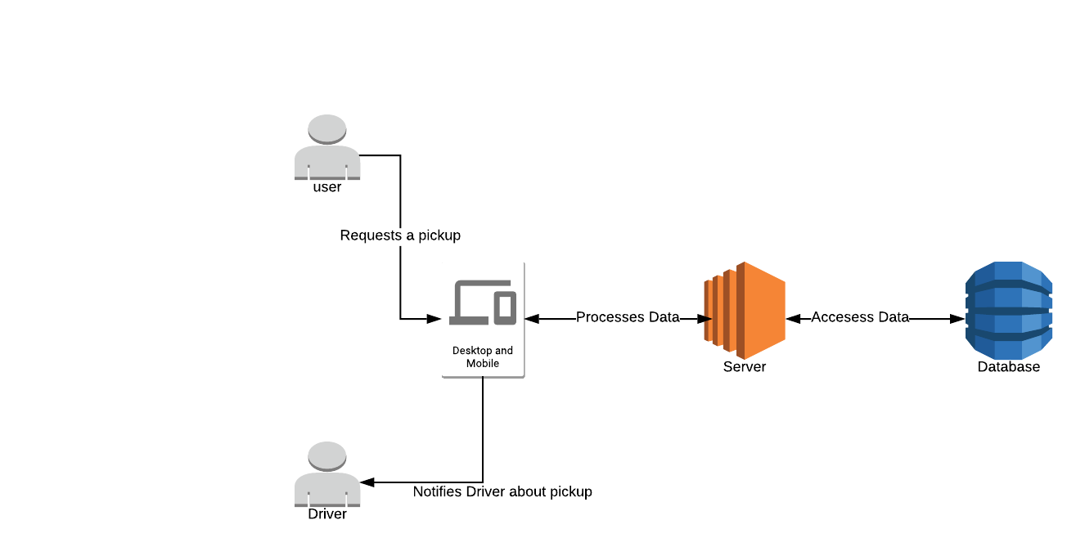
ARCHITECTURE

Slide 8
Technologies
Angular 7
Ionic
Mongo DB
Express JS
Node JS
Heroku / AWS

Slide 9
Collaboration Plan
We meet at home and complete the tasks
If out of station, we use zoom and hangouts to Interact

Slide 10
Trello and GitHub Links
https://trello.com/b/GkbG2Yf3
https://github.com/avinashganguri/umkc-ride

Slide 11
THANK YOU : )

